Slide 1

BASIC COMPUTER USAGE
FILES
AND
FOLDERS

Slide 2




NOTES REVIEW
05 MIN
To review the quality of your notes in teams
Are the notes clear? Understandable ?

Slide 3

OBJECTIVES FOR TODAY
What is a file, a folder
File attributes
Manipulate files and folders
Understand the window drives (C: D: )

Slide 4

DISCUSS
05 MIN
What is the purpose of each element here ?
A FOLDER
A FILE
THE ENTER KEY
THE CTRL KEY
HARD DRIVE
Notes:
A computer file is a computer resource for recording data in a computer storage device.

Slide 5
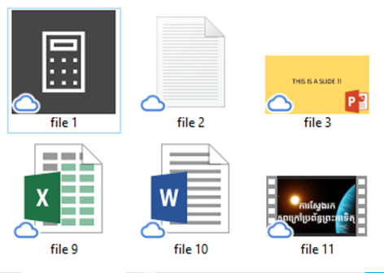
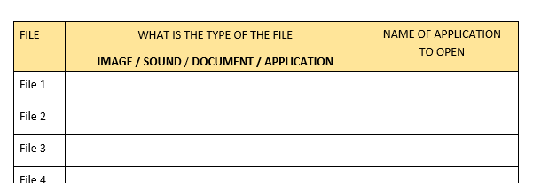
ACTIVITY
Activity 1
10 MIN
Get the files from your trainer
Follow instructions on paper

Slide 6





EXPLAIN
What is a file ?
05 MIN
A file is a set of data representing a specific type of information
AN EXCEL
DOCUMENT
A WORD
DOCUMENT
AN APPLICATION
AN IMAGE
A PDF FILE
Notes:
File extensions:
Exe for application
Docx for Word document
Pptx for power point
Txt text file

Slide 7
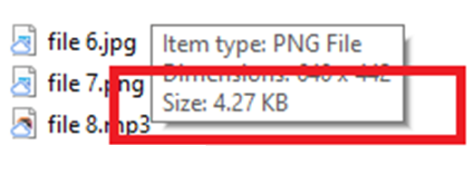
EXPLAIN
A file has a name
05 MIN
A name
An extension
A size
HELLO.XLS
File name
File extension
Move the mouse to the file
You will see its size

Slide 8
ACTIVITY
Activity 2
10 MIN
Follow instructions on paper
Notes:
It is a kind of brainstorm which introduce students the file

Slide 9

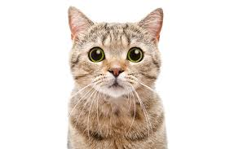




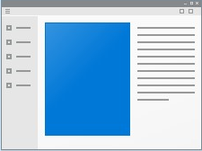




EXPLAIN
The file extension can tell you what is the file type
05 MIN
IMAGES
SOUND
VIDEO
APPLICATION
DOCUMENT
DOCX
JPEG
MP3
WAV
EXE
MP4
AVI
PDF
WMA
BAT
GIF
MOV

Slide 10

ACTIVITY
Activity 3
10 MIN
Follow instructions on paper
IMAGES
MEDIA
VIDEO

Slide 11

EXPLAIN
What is a folder ?
05 MIN
A folder is a container of files
A folder can also contain other folders
myDocument1
HELLO
myDocument2
myDocument3
Folder name

Slide 12
QUIZ
What is the size of this folder ?
05 MIN
??
10 KB
RONAN
myDocument1
5 KB
myDocument2
5 KB
myDocument3

Slide 13

EXPLAIN
File location
05 MIN
File and folders are stored in the hard drive of your computer

Slide 14
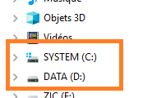
EXPLAIN
File location
05 MIN
Hard drives in Windows are represented with a letter (C: or D: )

Slide 15
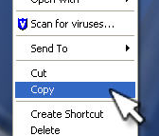
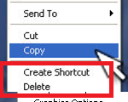
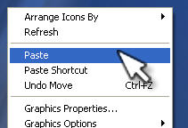
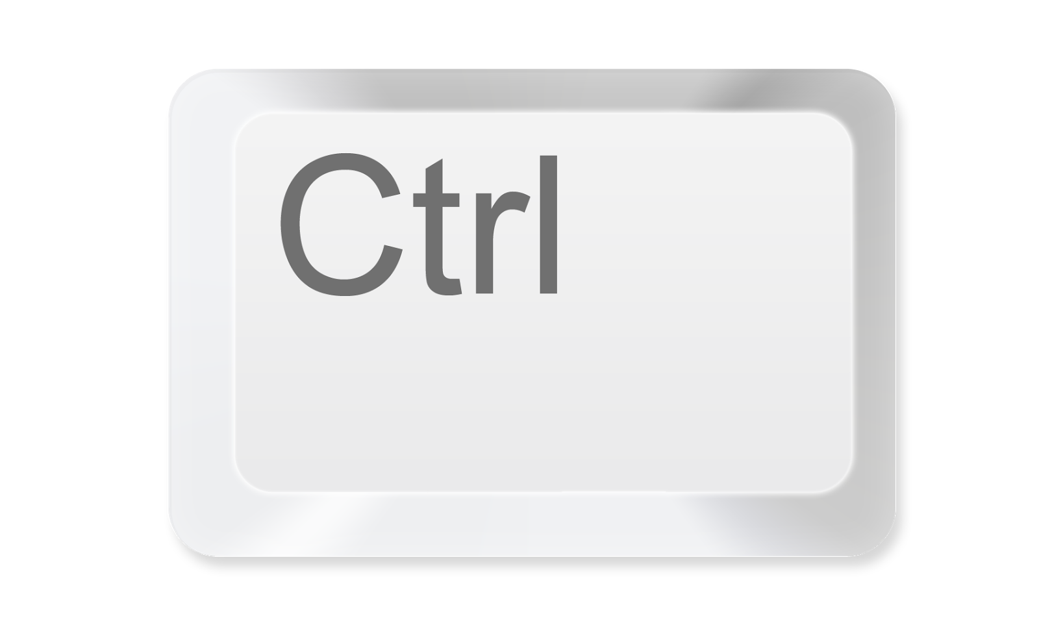



EXPLAIN
File manipulation
05 MIN
Copy file
Paste file
Delete file
Notes:
Manipulation = tip

Slide 16
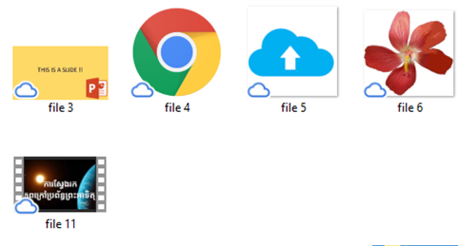
ACTIVITY
Activity 4
10 MIN
Follow instructions on paper
Notes:
It is a kind of brainstorm which introduce students the file

Slide 17
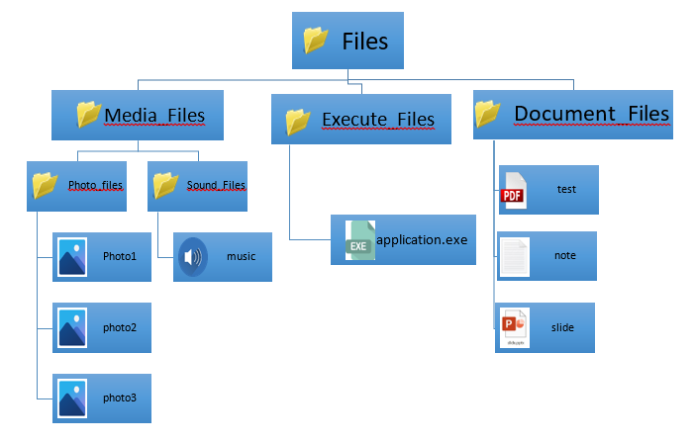
ACTIVITY
Activity 5
10 MIN
Follow instructions on paper
Notes:
It is a kind of brainstorm which introduce students the file

Slide 18


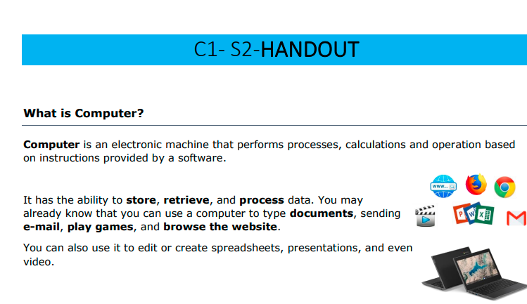
HOMEWORK
Howemork
Review the slides send by the teacher
Review your draft notes
Write clean notes on your BCU workbook
Read the handout
Answer the questions
DRAFT NOTES
BCU NOTEBOOK

